Slide 1
Implementation of Security Measures in IT
By Rajbir Singh

Slide 2
Vulnerability
Deprecated SSL and TLS version
Impact
Critical
Solution
In Windows, create new registry values of SSL version and set their values to DWORD 0.

Slide 3
SSL
SSL (Secure Sockets Layer) is a cryptographic protocol designed to secure communication between clients and servers over the internet.
It provides encryption, authentication, and data integrity, ensuring that sensitive information remains private and protected.

Slide 4
Problem with SSL
Weak Encryption:
Older versions of SSL, such as SSLv2 and SSLv3, suffer from known vulnerabilities and weak encryption algorithms.
Certificate Validity:
SSL certificates have a finite validity period, typically ranging from a few months to a few years. If certificate renewal processes are not managed properly, it can lead to expired certificates, resulting in interrupted or insecure connections.

Slide 5
Solution
reg add "HKEY_LOCAL_MACHINE\SYSTEM\CurrentControlSet\Control\SecurityProviders\SCHANNEL\Protocols\SSL 2.0\Client" /v DisabledByDefault /t REG_DWORD /d 1 /f
reg add "HKEY_LOCAL_MACHINE\SYSTEM\CurrentControlSet\Control\SecurityProviders\SCHANNEL\Protocols\SSL 2.0\Client" /v Enabled /t REG_DWORD /d 0 /f
reg add "HKEY_LOCAL_MACHINE\SYSTEM\CurrentControlSet\Control\SecurityProviders\SCHANNEL\Protocols\SSL 2.0\Server" /v DisabledByDefault /t REG_DWORD /d 1 /f
reg add "HKEY_LOCAL_MACHINE\SYSTEM\CurrentControlSet\Control\SecurityProviders\SCHANNEL\Protocols\SSL 2.0\Server" /v Enabled /t REG_DWORD /d 0 /f

Slide 6
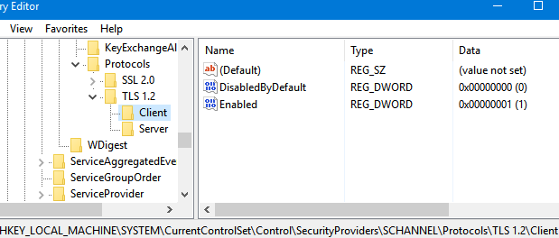

Slide 7
Vulnerability
SNMP Agent Default Community Name (public)
Impact
High
Solution
Disable SNMP service from printer settings or use SNMP v3.

Slide 8
SNMP:
SNMP (Simple Network Management Protocol) is a widely used network management protocol that enables administrators to monitor and manage network devices and systems.
It provides a standardized framework for collecting and organizing information about network devices, such as routers, switches, servers, and printers.
Problem:
Security Vulnerabilities: SNMP versions prior to SNMPv3 lack robust security features. SNMPv1 and SNMPv2c use community strings for authentication, which can be easily intercepted and compromised. This makes SNMP communication susceptible to unauthorized access, eavesdropping, and tampering.

Slide 9
Vulnerability
rsh Service Detection
Impact
High
Solution
Disable rsh service from printer settings

Slide 10
rsh (Remote Shell)
RSH (Remote Shell) is a service that allows users to execute commands on remote systems over a network.
This is a legacy service often configured to blindly trust some hosts and IPs. The protocol also doesn't support encryption or any sort of strong authentication mechanism.

Slide 11
Vulnerability
Unencrypted Telnet Server
Impact
Medium
Solution
Turn off Telnet from “Turn Windows features on or off” setting in Control Panel

Slide 12
Telnet
Telnet is a network protocol used for remote access and control of devices over a network.
It allows a user to establish a text-based, bidirectional communication session with a remote device or server.
Problem with using Telnet:
Telnet transmits data, including usernames, passwords, and commands, in clear text, which makes it vulnerable to eavesdropping and interception.

Slide 13
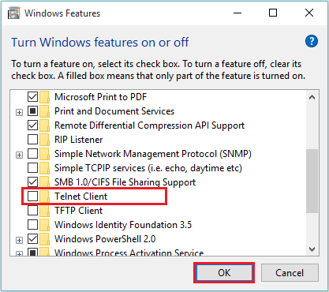

Slide 14
Vulnerability
SMB Signing not required
Impact
Medium
Solution
Enforce message signing in the host's configuration. On Windows, this is found in the policy setting 'Microsoft network server: Digitally sign communications (always)'.

Slide 15
SMB Signing
SMB signing, also known as Server Message Block signing, is a security feature in the SMB protocol used by Windows operating systems for file and printer sharing over a network.
It is designed to ensure the integrity and authenticity of SMB communications between a client and a server. It helps protect against tampering and unauthorized modification of data in transit.

Slide 16
Vulnerability
IP Forwarding Enabled
Impact
Medium
Solution
On Linux, you can disable IP forwarding
by doing :
->sudo -i
->echo 0 > /proc/sys/net/ipv4/ip_forward
On Windows, set the key 'IPEnableRouter' to 0 under HKEY_LOCAL_MACHINE\System\CurrentControlSet\Services\Tcpip\Parameters

Slide 17
IP Forwarding
IP forwarding, also known as IP routing, is a fundamental function of network devices, such as routers and switches. It involves the process of forwarding IP packets between different network segments or subnets.
Problem:
An attacker can exploit this to route packets through the host and potentially bypass some firewalls.

Slide 18
More changes to secure a system
Access Control
Regular Patching and Updates
Firewalls
Monitoring and Auditing
Encryption

